Slide 1

教学辅助课件
牛津 七年级下

Slide 2




Unit 3
Welcome to Sunshine Town!
Study skills

Slide 3



Objectives
To master the rules of stress in sentences
To know how to express different meanings by stressing different words

Slide 4


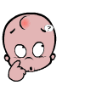

Stress in sentences
When we speak English, we often stress important words. We don’t usually stress less important words.
What should we stress?
How do we stress them?
why do we stress them?

Slide 5

What should we stress?
名词
形容词
My aunt is a teacher in a middle school.
Mr Lin is going to visit the USA next month.
动词
副词
We do not usually stress less important words, 如: 冠词、介词、代词、连词。
We often stress important word, 如: 名词、动词、形容词、副词。

Slide 6


How do we stress them?
When we read stessed words, the tone should go up.
Practice
My aunt is a teacher in a middle school.
Mr Lin is going to visit the USA next month.

Slide 7
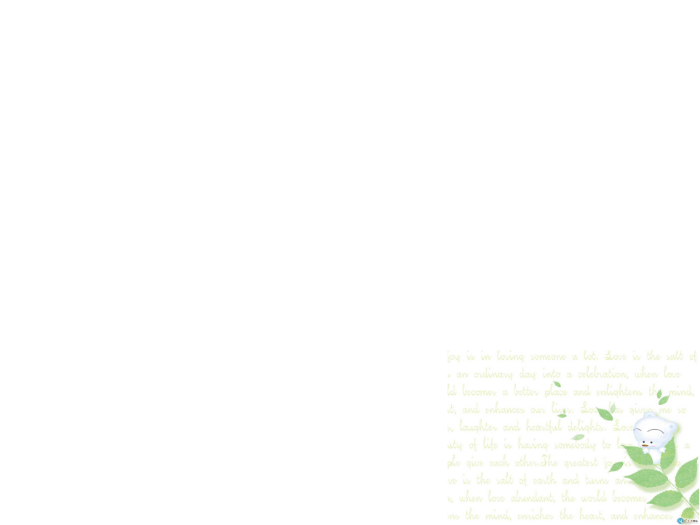
Why do we stress them?
We can stress some of the words to show that they are more important and express the special meanings.
An example
Mr Li owns a four –bedroom flat.
It is Mr Li that owns a four-bedroom flat.
He doesn’t rent the flat from others.
It is a four-bedroom flat, not another kind of flat.
It is a flat, not a house.

Slide 8


Listen to the following conversation. Pay attention to the stressed words.
A
Millie: Where are you going, Daniel?
Daniel: I’m going to the book shop.
Millie: What are you going to buy?
Daniel: My pen is broken. I want to
buy a new one.
Millie: I need some exercise books.
Can I go with you?
Daniel: Sure.
P39

Slide 9


Read the sentences below. Stress the different words according to the meanings you want to express.
B
1. I want to buy a CD at the bookshop.
a. I am talking about what I want to do,
not what I do not want to do.
b. I am talking about a bookshop, not
another kind of shop.
c. I am talking about a CD, not something
else.
P39

Slide 10
2. Daniel sometimes watches TV on Sunday mornings.
a. I am talking about watching TV, not
another activity.
b. I am talking about Daniel, not another
student in the class.
c. I am talking about Sundy morning, not
another morning.
P39

Slide 11




Slide 12

阅读下面的句子，根据你想要表达的意思在横线上写出需要重读的单词或词组。
1. There are over 8.6 million works of art in the Palace Museum.
(1) I’m talking about the things in the Palace Museum.
(2) I’m talking about the Palace Museum,
not any other places.
(3) I’m talking about the number of works of art.
works of art
the Palace Museum
over 8.6 million

Slide 13

2. Molly is looking forward to watching
Beijing opera on Sunday.
(1) I’m talking about what Molly wants to
do, not what she doesn’t want to do.
Beijing opera
(2) I’m talking about Sunday, not another day.
(3) I’m talking about Molly, not any other people.
watching
Sunday
Molly

Slide 14
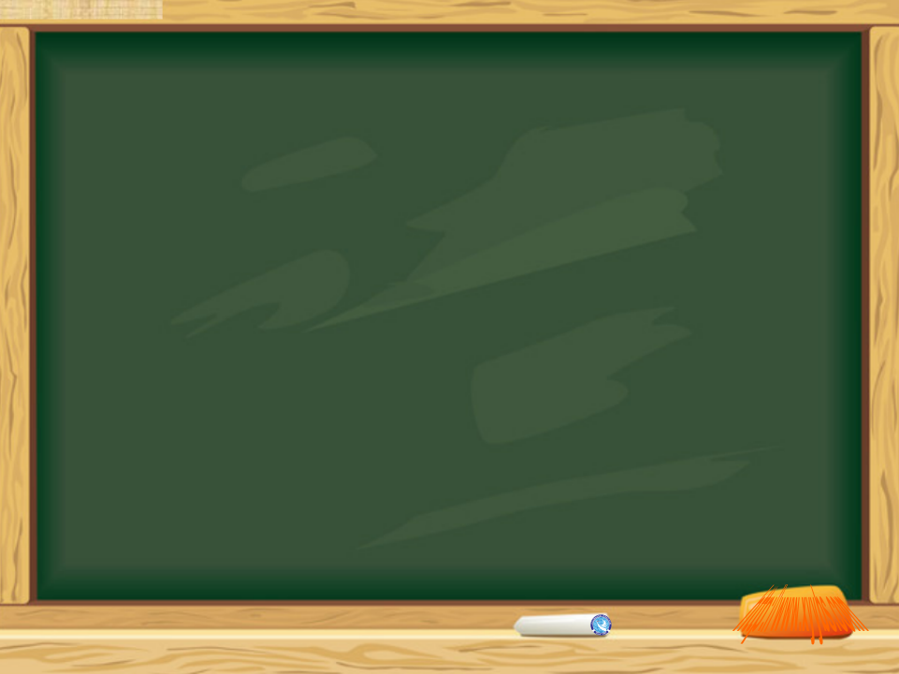

1. Read the sentences on page 39.
2. Preview Task on P40.

